Slide 1
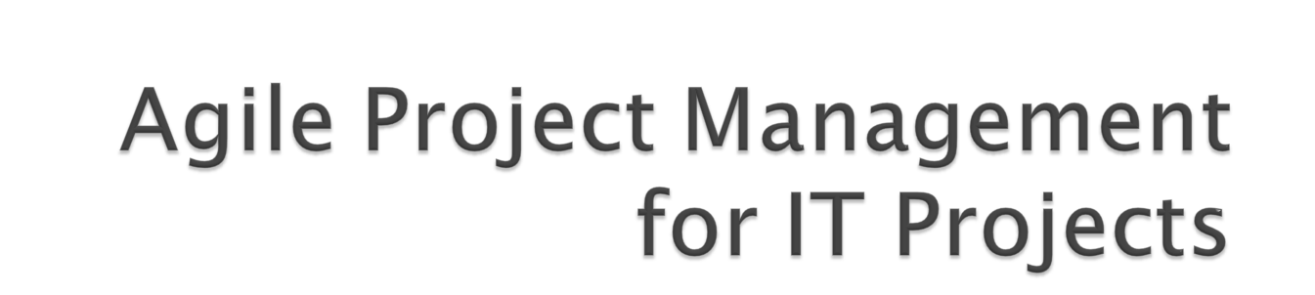
Submitted By:
Rachna Nainani

Slide 2

A project is a temporary endeavour undertaken to create a unique product or service.
Temporary means that every project has a definite beginning and a definite end.
Unique means the product or service is different in some distinguishing way from all similar products or services.

Slide 3

Project Management is the application of knowledge, skills, tools and techniques to project activities in order to meet or exceed the stakeholder needs and expectations from a project. Meeting or exceeding stakeholder needs and expectations invariably involves balancing competing demands among:
  Scope, time, cost, and quality.
  Stakeholders with different needs and expectations.
  Identified requirements (needs) and unidentified requirements (expectations).

Slide 4

Agile methods are approaches to manage the development of Internet products and services based on principles of early customer involvement, iterative development, self organizing teams, and flexibility.
Agile is a principles-based development approach that speeds delivery and controls costs by minimizing overhead, ensures closer fit to business needs through stronger collaboration, and reduces risk through rapid releases of valuable and usable business functionality.

Slide 5

Agile processes include three major attributes,they are:
Incremental and Evolutionary – allowing adaptation to both internal and external events.
Modular and Lean – allowing components of the process to come and go depending on specific needs if the participants and stake-holders.
Time Based – built on iterative and concurrent work cycles, which contain feedback loops and progress checkpoints.

Slide 6

Continuous integration-The process of creating working versions of code quickly and on a regular basis (daily or more frequently depending on the methodology) for testing and user review.
Iterations-An agile development cycle involving design, code and test of a preselected series of features or requirements. Depending on the methodology used, a typical iteration may be as short as two weeks or as long as three months.
Pair programming-A technique that uses two developers working side by side on the same assignment. It encourages continuous interaction and review of each other’s work.

Slide 7
Refactoring-An agile technique for restructuring a unit of code to simplify its design and operation without changing its functionality.
Stories-Short descriptions of a desired feature or function written in a narrative manner. Stories describe how a user imagines a feature being used rather than an approach for implementing that feature.
Use cases-A more formal description of functionality that describes the expected behavior of the desired functionality. Use cases guide development of the functionality and are also the basis for test cases that verify if the implementation is correct.

Slide 8

Communication
Simplicity
Feedback
Courage
Humility

Slide 9

Assume Simplicity - Overbuilding the system or any artifact of the project must be avoided.
Embrace Change - The stake-holder understanding of the requirements will change over time. Project stakeholders may change their point of view, which in turn will change the goals and success criteria of the project management effort.
Enabling The Next Effort Is Also A Goal - Part of fulfilling the needs of the project stakeholders is to ensure that the system is robust enough to be extended over time. Using Alistair Cockburn concept, “when you are playing the software development game your secondary goal is to setup to play the next game.”

Slide 10
Incremental Change - Instead of futilely trying to develop an all encompassing project plan from the start, put a stake in the ground by developing a small portion of the system, or even a high–level model of a larger portion of the system, and evolve this portion over time.
Maximize Stakeholder Value - the project stakeholders are investing resources -time, money, facilities, etc. - to have a system deployed that meets their needs.
Manage With A Purpose - Identify why and for whom the artifact is created. Identify a valid purpose for creating the artifact and the audience for that artifact. This principle also applies to a change to existing artifacts.
Multiple Project Views -provide different views of the same process for different audiences.

Slide 11
Rapid Feedback - Work closely with the stake-holders, to understand the requirements, to analyze those requirements, and develop a actionable plan, which provides numerous opportunities for feedback.
Working Software Is The Primary Goal of the Project - the goal of any software project is to produce software that meets the needs of the project stakeholders.
Travel Light -every artifact that is created, and kept, will need to be maintained over it’s life cycle. The effort needed to maintain these artifacts must be balanced with their value.

Slide 12

Learn to Decompose Project Work
Understand and Address Architectural Implications
Increase Investment in Supporting Infrastructure

Slide 13
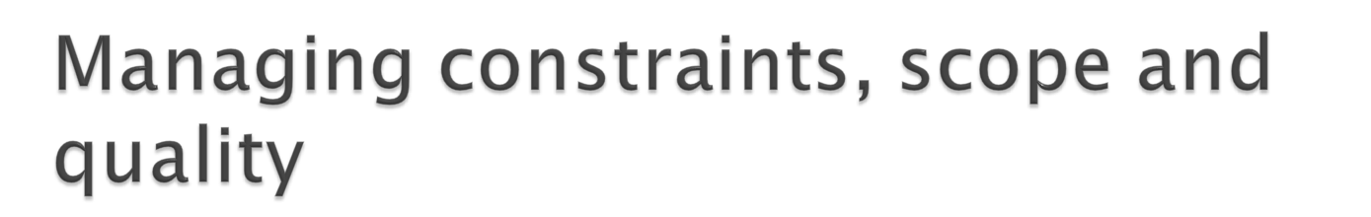
Constraints -Managing changes and constraints are one of the essences of Agile management. The way the project is managed will allow the customer to minimize cost of change while taking into account constraints.
Scope - In agile world project, frozen specifications of the final product and abominable snowman are alike: they are both myth and don’t exist in organization dynamics. Rather than defining during the initiation phase the entire project (scope, work breakdown structure, assumptions, etc), the project manager will focus on planning for the horizon.

Slide 14
Quality
In agile methodology, quality is planned at the beginning of the project and is continuously present throughout the project lifecycle.
Agile software development put the Quality Assurance in the center of the project management methodology. Because of iterative development and continuous improvement, quality assurance will be involved into the analysis, design and review processes.

Slide 15

Make Use of Pilots
Use a Coach during the Transition
Implement the Process First, Tools Will Follow
Learn from Experience

Slide 16

Align the ‘Customer’ with the Teams - Having a strong Voice of the Customer (VoC) is critical to the successful implementation of any methodology.
Understand Customer Commitment Implications

Slide 17
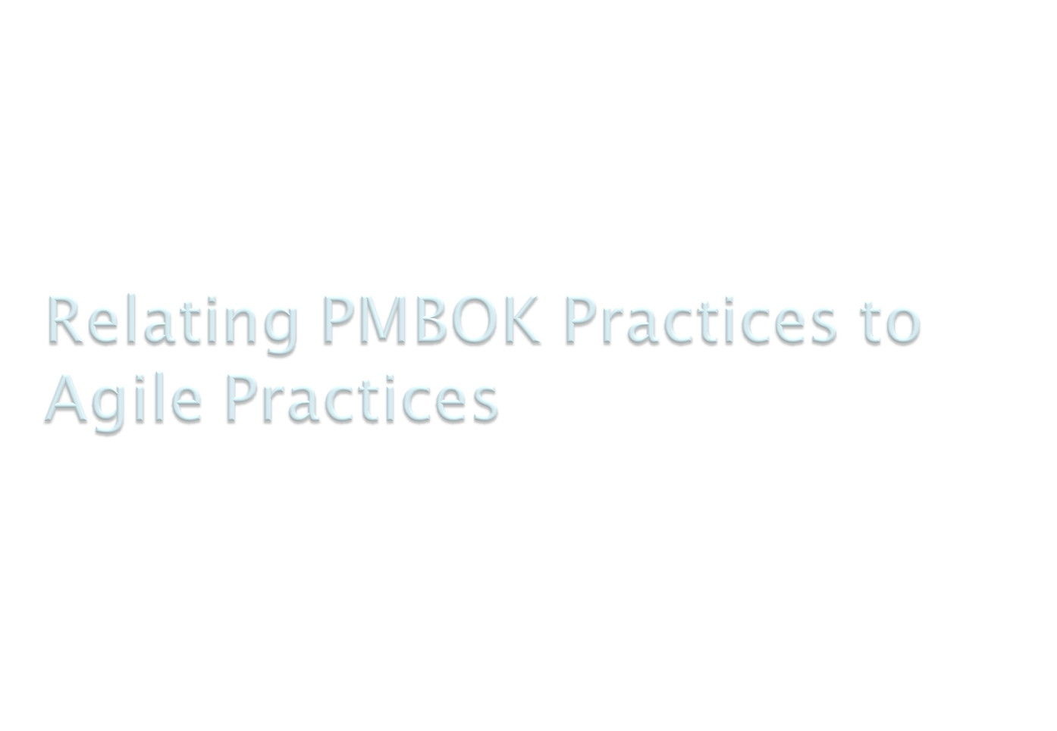

Slide 18
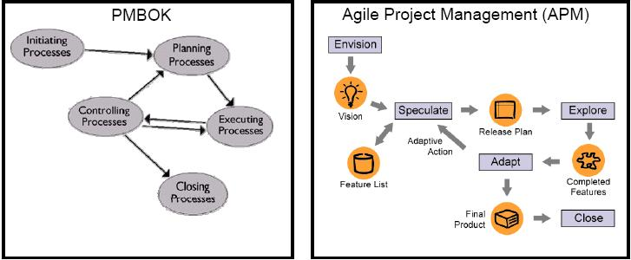

Slide 19
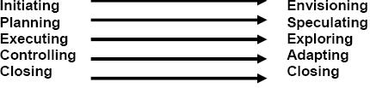
PMBOK Project Management Process Groups mapped to Jim Highsmith’s Agile Project Management framework.

Slide 20
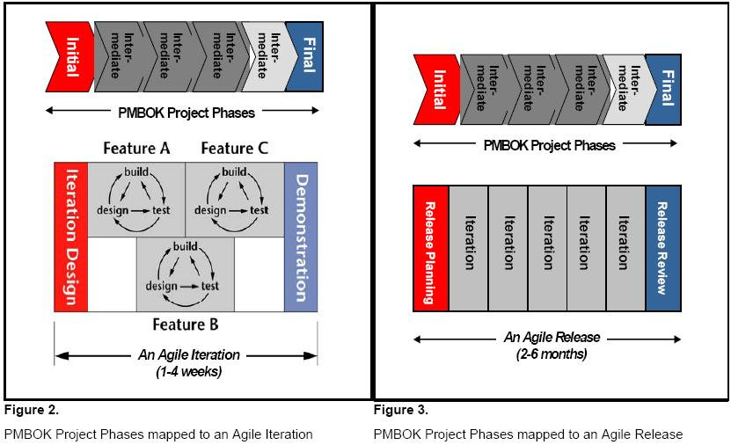

Slide 21

Delivers better systems
Responsive to change
Less risky
Delivers greater business value
Attractive to the developers

Slide 22

Myth 1: Agile Development is Undisciplined
Continuous Integration, Test Driven Development, Refactoring and even the controversial pair programming are not practices for the undisciplined. Even more indicative of the discipline required, the continuos delivery of running tested software every weeks could be characterised as the ultimate software discipline.

Slide 23
Myth 2: Agile Teams do not plan
Most agile teams spend as much, if not more, time planning their projects. The difference is that this planning effort is spread throughout an entire project as opposed to being compressed into the beginning of the project.

Slide 24
Myth 3: Agile Development is not predictable
Agile Development instead replaces detailed, speculative plans with high level, feature driven plans that acknowledge the inherent complexity and uncertainty of software development projects.
As opposed to planning once a year and executing against that plan for the remainder of the project, agile teams are constantly planning, estimating, prioritising and delivering against that plan.

Slide 25
Myth 4: Agile Development does not scale
The larger the project’s scope the greater the chances of failure, the greater the number of people involved in the project, the greater the communication risk and complexity.
Agile Development simply accepts these realities and recommends smaller projects, shorter delivery timeframes and smaller teams.

Slide 26

http://agilemethodology.org/
http://www.targetprocess.com/?gclid=COH6jJTljZgCFRnBbwod5hW-XA
http://www.projectsmart.co.uk/pmbok.html
http://crystalmethodologies.org/
“Agile Modeling,” Scott Ambler : www.agilemodeling.com
CDL Systems : Agile Estimation and Planning
CC Pace : Agile Project Management
IBM : Architectural manifesto: Adopting agile development
Construx Software : Optimising Agile For Your Organisation
PM World Today : Estimating and Tracking Agile Projects
Compuware : Just Enough Agile: Understanding the principles of Agile Development
Rally Software Development Corporation : A Project Manager’s Survival Guide to Going Agile
Zdnet : Agile Project Management Methods for IT Projects

